Slide 1

Fault Detection for the Control of Supermarket Refrigeration Systems
Zoltan Mark Pinter
Supervisors: Hans Henrik Niemann, Dimitrios Papageorgiou
External Supervisor: Lars Finn Sloth Larsen
3th September, 2019

Slide 2
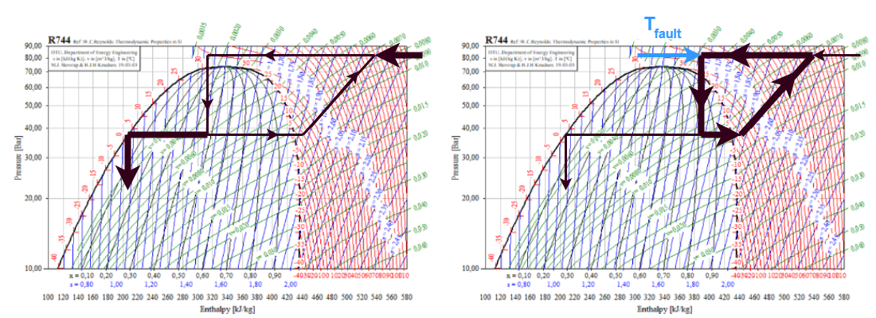
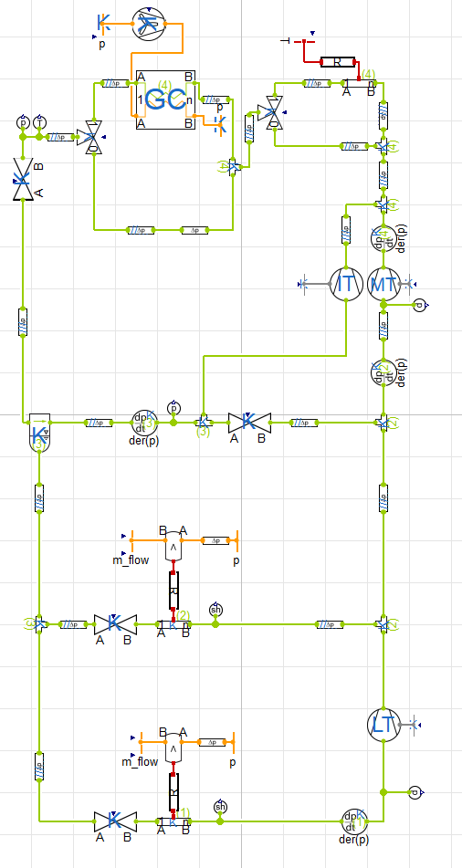
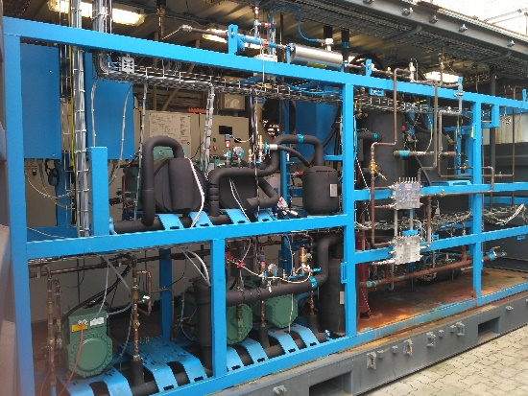
Schedule
Introduction
Gas Loop Problem
Project goal
Project scope
Physical and Mathematical Model
Short introduction to the investigated plants
State estimator
Residual analysis
Recursive Least Squares (RLS) algorithm
Fault Detectors
Results and Evaluation
Conclusion and Discussion
Notes:
Gas loop: measurement error, reducing efficiency, heating up cabinets
Project goal: early detection and fault accommodation
Project scope: field experiment and simulation
Operation domain: 10…30 degrees.
Fault diagnosis problem is separated.
Rest of schedule

Slide 3
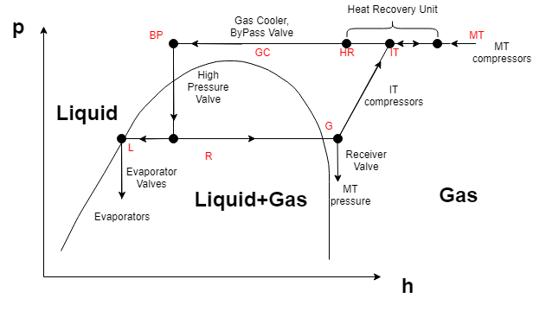
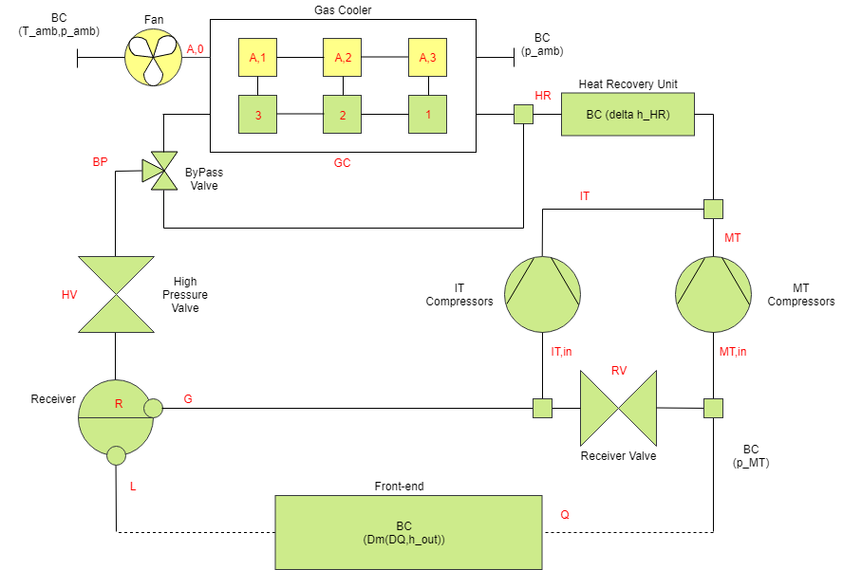
Physical model
Back-end and front-end
Different dynamics
Notes:
Front end: distributed control for all cabinets, swift dynamics, boundary condition
Main components (left)
Gas cooler is divided to equal control volume cells, as heat transfer depends on spatial distribution of properties
2 cell for initial, 1 cell for final model
Where the fault occurs.
Parts of ph diagram
Mass flow rates

Slide 4
The gas loop
Notes:
Controller perceives the left figure version
Enthalpy temperature gradient magnifies the effect.
Higher enthalpy passed to receiver. Increasing pressure, saturating IT compressor
Cabinets heat up

Slide 5
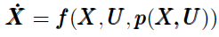
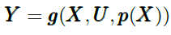
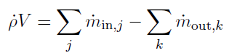
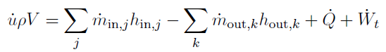
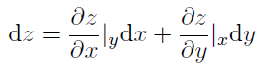
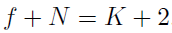
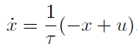
Mathematical model – differential equations
Goal: state space model description
Applied differential equations
Mass balance equation
Energy balance equation
Chain rule
Two properties: given by the phase rule
Low pass filter

Slide 6
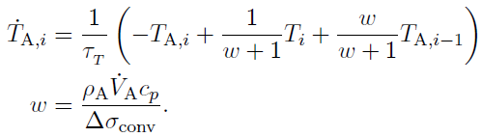
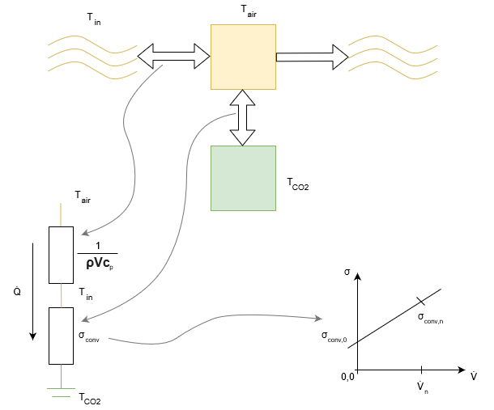
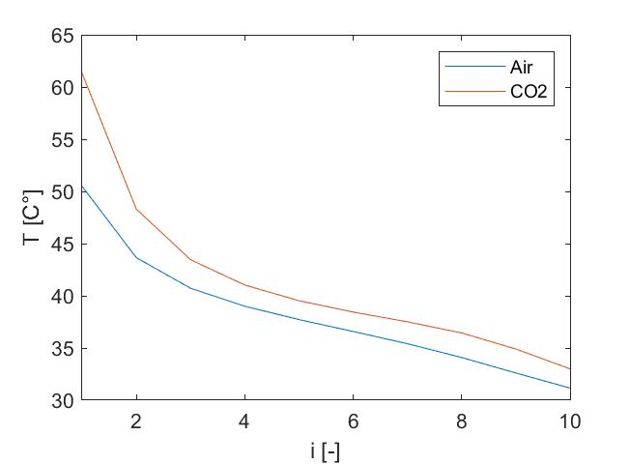
Mathematical model – heat transfer
Energy balance
Most assumptions are made here
Linear resistance model
First order convection model
Neglected spatial temperature difference distribution
for cells

Slide 7
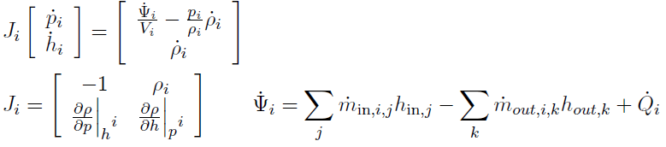
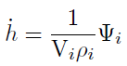
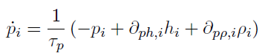
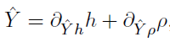
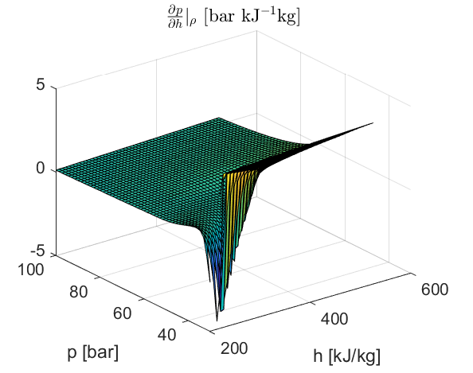
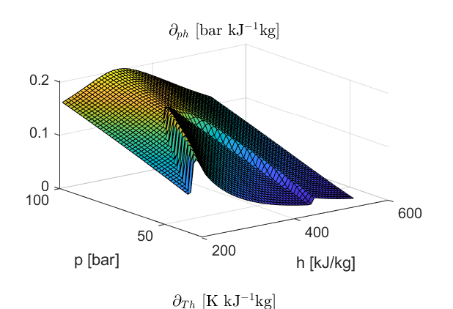
Mathematical model - simplifications
Main problems
Controllability issues
Information distribution of estimator
Large range of partial differentials
Solutions
No bypass valve and heat recovery unit
One-cell gas cooler
Perception of dynamics
Look-up table, assuming steady state

Slide 8
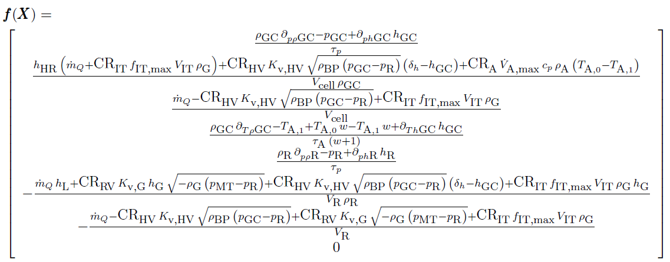
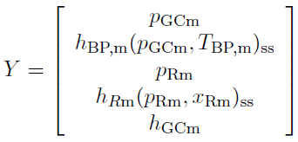
Mathematical model
Nonlinear model
Disturbance: enthalpy difference
Linearization
Analysis at a set-point
Conversion to discrete time (1s)
Notes:
List the final states on the figure!

Slide 9
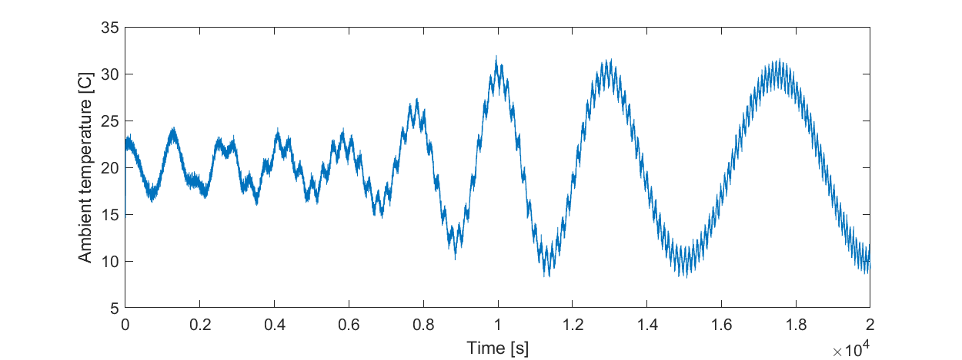
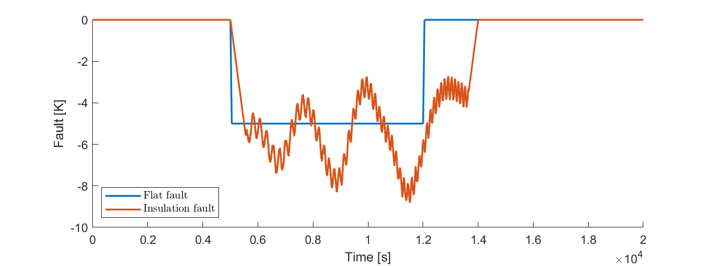
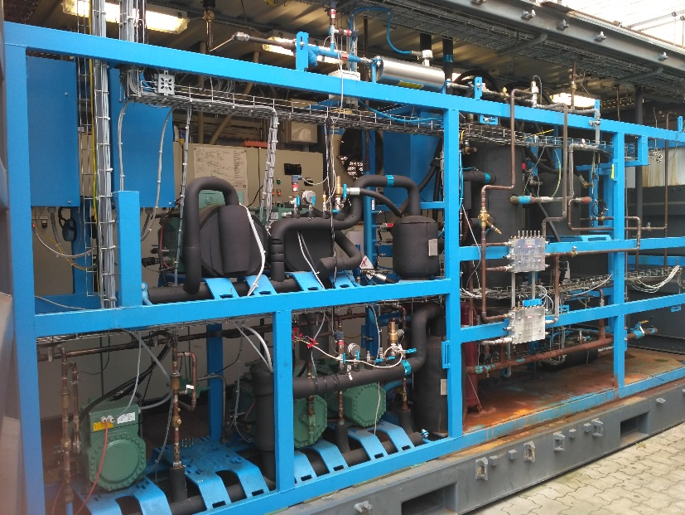
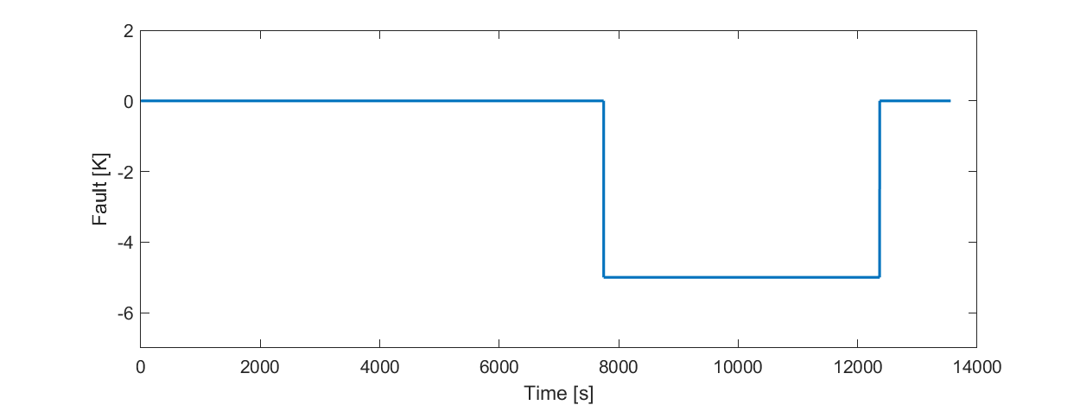
The plants
Field experiment
Simulation
Notes:
The two plants
Step fault: switch-on switch-off
For the Modelica plant, insulation
Ambient temperature: increasing amplitude for testing estimator robustness

Slide 10
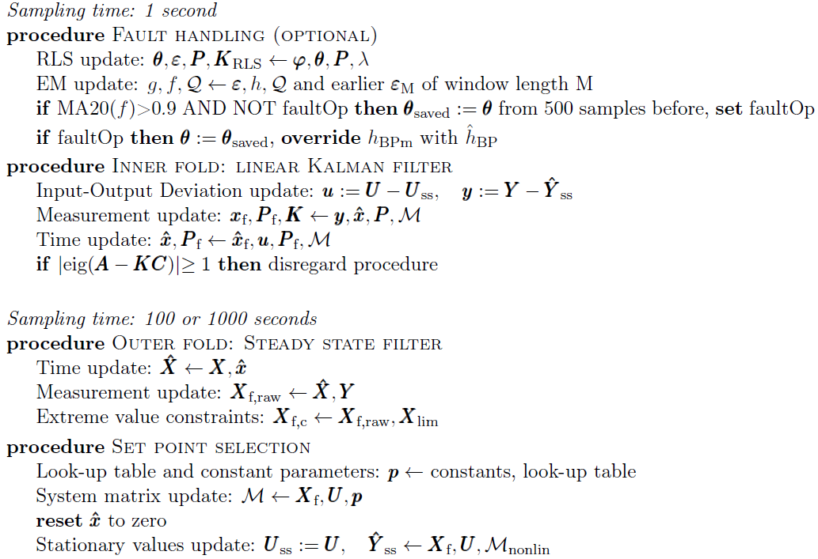
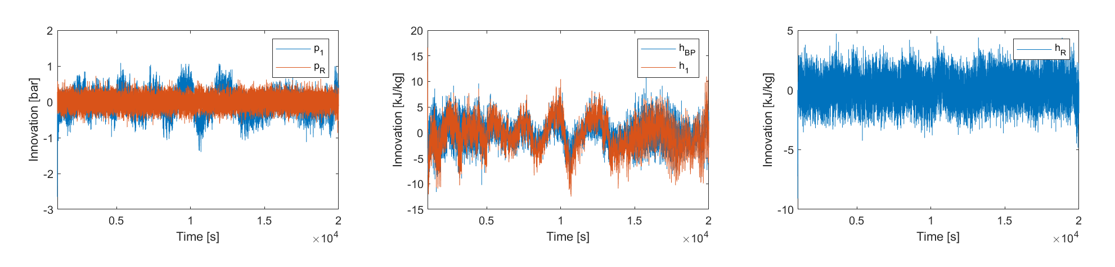
The state estimator
Fault handling (optional)
Inner fold: linear dynamical
Kalman filter
Outer fold: steady state filter
Set point selection
Notes:
Two different sampling times
Fault handling is independent from state estimator for modularity
Describe parts
Innovation: operation point change same effect as fault

Slide 11
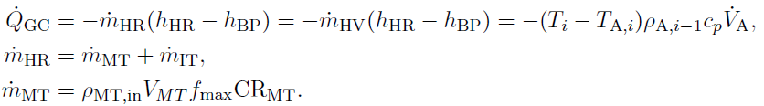
Parameter estimation and residuals
The main challenges are
Set-point change has the same effect as the fault
Dynamical signals
Non-Gaussian noise
Physical background
Energy accumulation should be bounded in the gas cooler
Notes:
Main challenges
Physical background: heat flow rate should be the linear combination of the energy flow rates
Error of this assumptions is caused by transients, energy accumulation
Error is bounded in case of normal operation

Slide 12
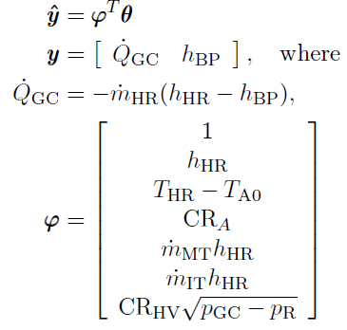
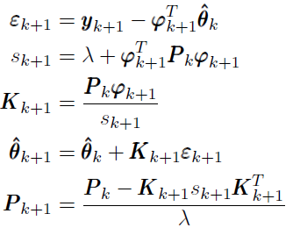
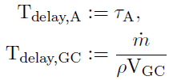
Parameter estimation and residuals
Recursive linear Least Squares (RLS)
Problem with information density
Regularization and robustness
The ambient temperature perturbed the system sufficiently
Forgetting factor
Time delays
Residual whitening: less normal signals

Slide 13
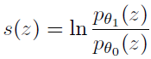
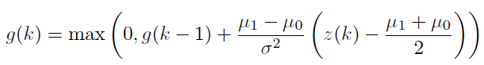
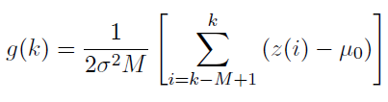
Fault Detection
Signal choices
Residual for detection: heat transfer
Residual for reconstruction: enthalpy
Log likelihood ratio
CUSUM
GLR
Window length (M) : 100 s
2

Slide 14
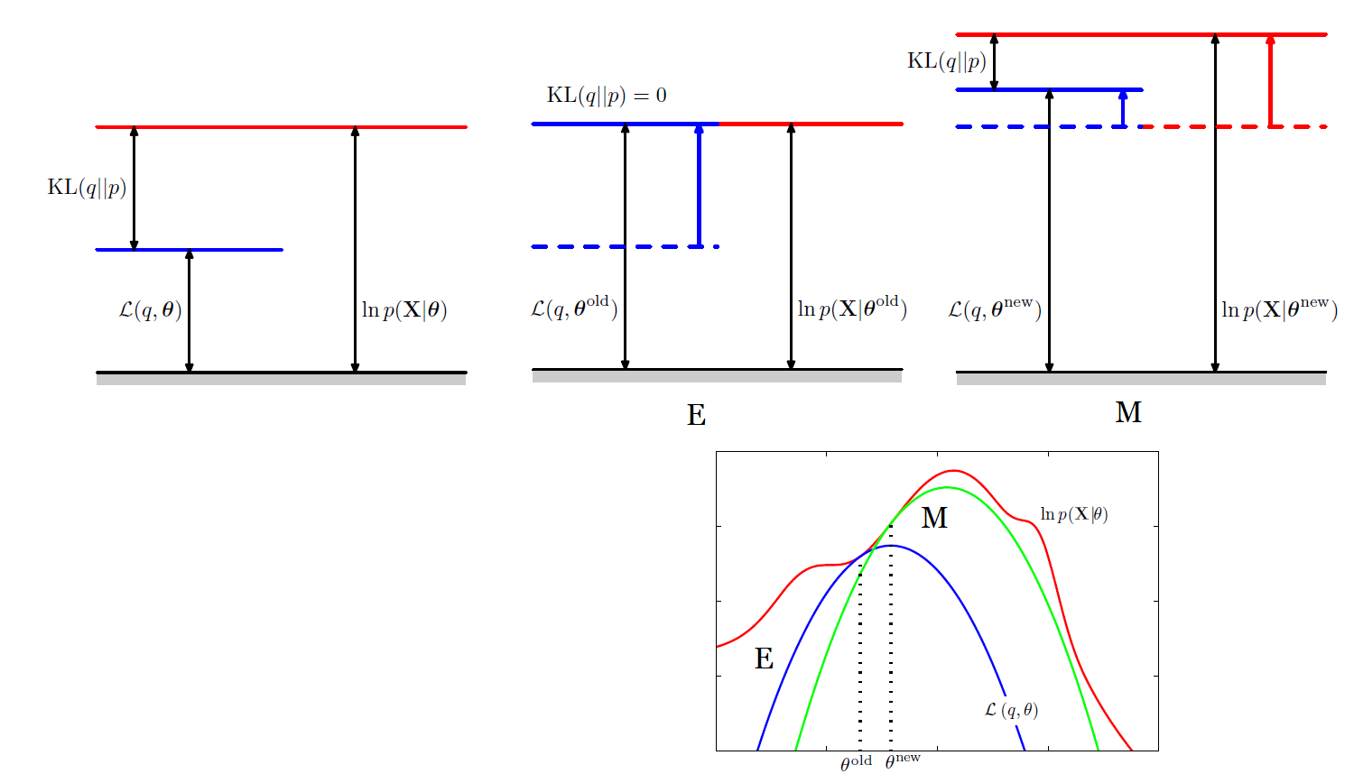
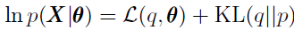
Fault Detection – Expectation Maximization
Latent variable models
E (expectation) step: changing the structure
M (maximization) step: changing the parameters
Notes:
Algorithm from field machine learning, to maximize likelihood for latent variable models
Latent variable model: there are unobserved variables, which are projected on the data.
E step. Changing the structure is to minimize the misfit between the distributions, which is called the KL divergence
M step: parameters are modified to maximize likelihood

Slide 15
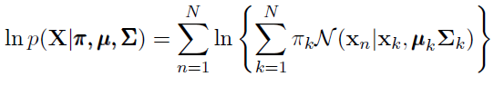
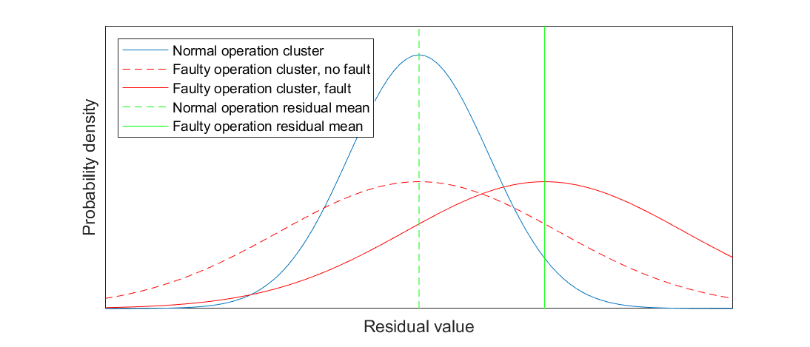
Fault Detection – Expectation Maximization
Gaussian Mixture Model (GMM) with two clusters:
Normal and faulty operation clusters
The following log likelihood is maximized:
Window length: 10 s
Notes:
GMM with two clusters
Window length of 10 data
Prob. density value for normal operation cluster is higher, its responsibility is higher
The more the mean diverges, the swifter the fault tracking becomes, as the faulty cluster takes more responsibility
When the prob. density value of the faulty cluster is higher, alarm is fired.

Slide 16
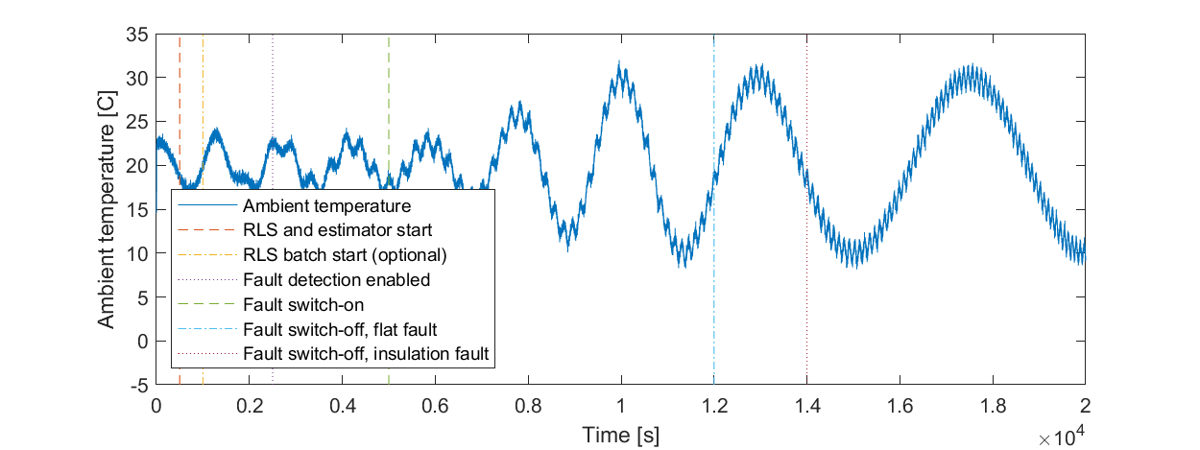
Fault handling
Fault handling does not stop until human intervention
Strong detectibility and measurement reconstruction are achieved by freezing the parameter values after detection

Slide 17
Results and Evaluation
Objectives
Fault detectors
Measurement reconstruction
Application
Control performance
State estimation quality

Slide 18
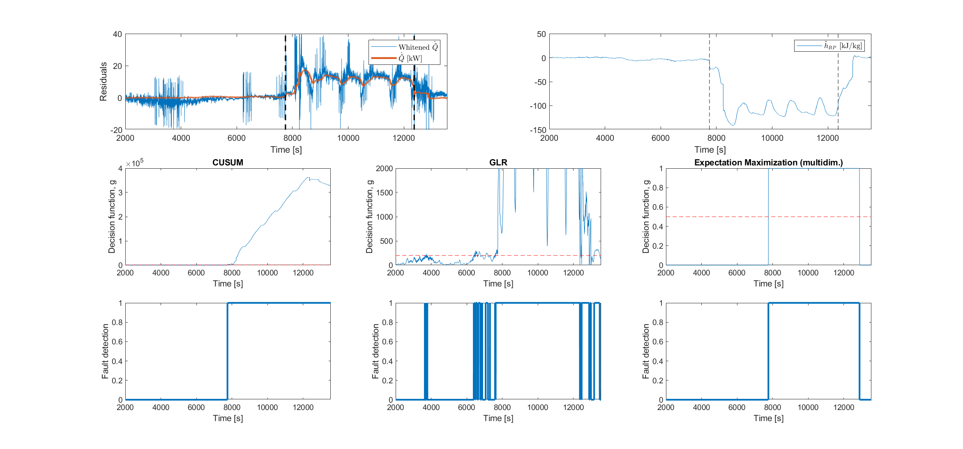
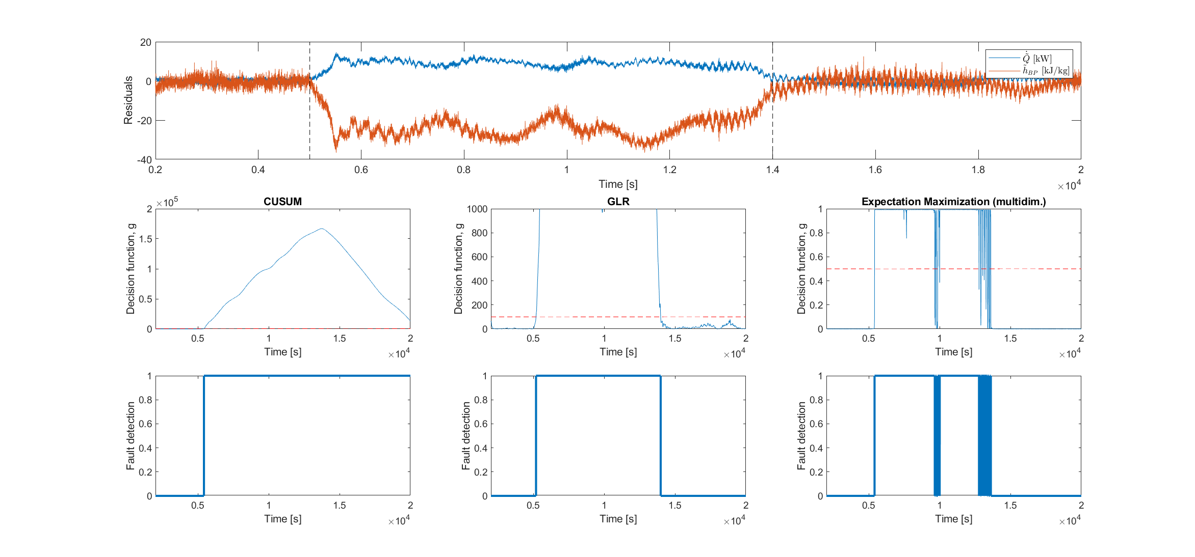
Results and Evaluation - fault diagnosis
Residual signals: strong detectibility
Fault detector
Detection times
Notes:
Strong detectbility is guaranteed.
Left side, right side
CUSUM: slowness. GLR: false alarms. EM: missed detection
Threshold dependency

Slide 19
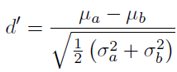
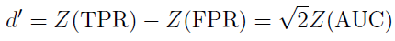
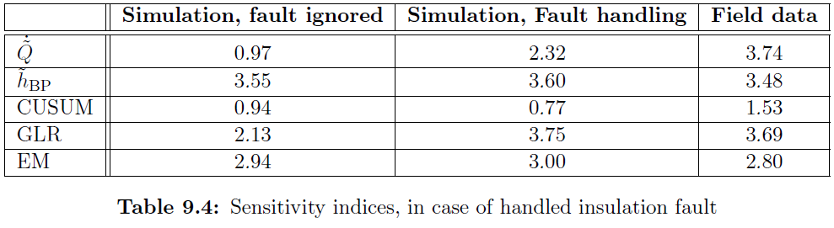
Results and Evaluation - fault diagnosis
Fault detector
Area under the ROC curve, and sensitivity index
Notes:
Threshold free method: AUC, directly relates to the better scaled sensitivity index from the field of signal processing
Best classifier: enthalpy residual, but slow dynamics: large detection time
Best detectors for this case: GLR and EM

Slide 20
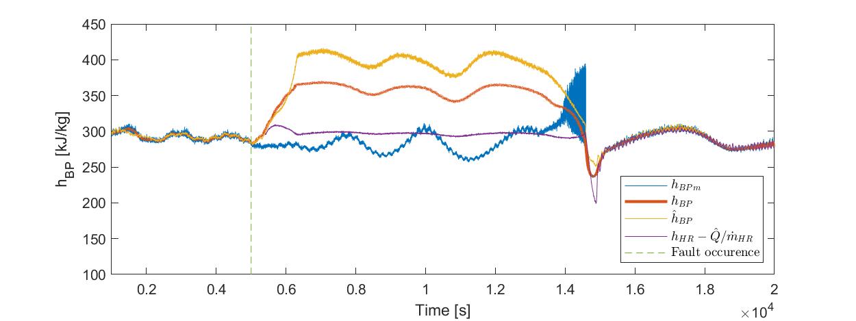
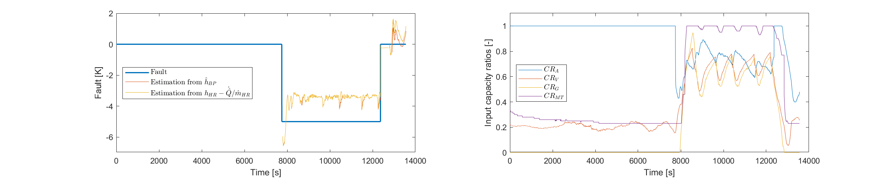
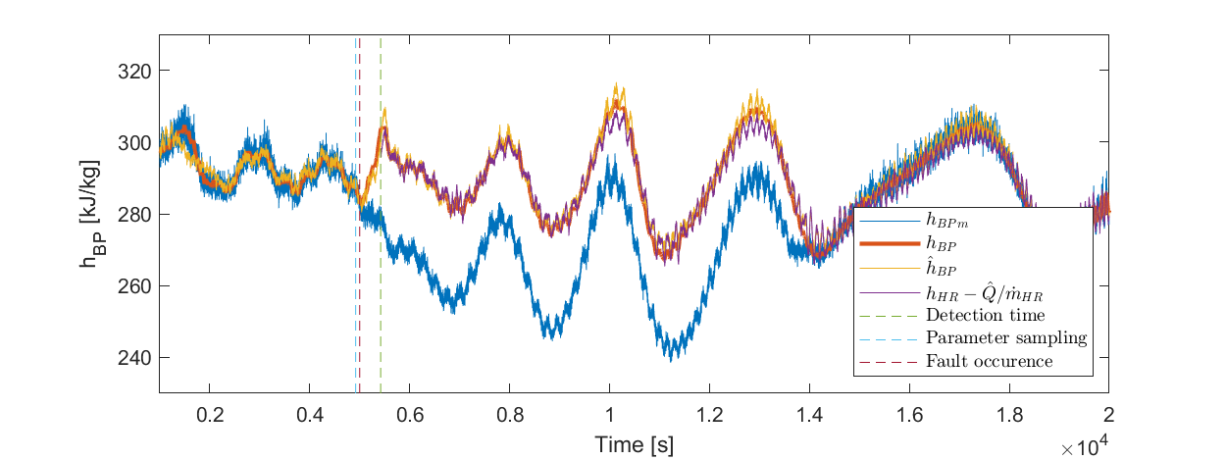
Results – measurement reconstruction
For simulations, insulation fault scenario is considered
Notes:
Insulation fault scenario is considered
Left box: up: no fault handling, down: fault handling
Since new operation points are discovered outside of normal operation, large estimation errors
Right box: temperature fault estimation. Due to small perturbance of regressors, 30% of error

Slide 21
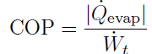



Results and Evaluation – control performance
Coefficient of performance
Cabinet temperatures
Inputs are no longer saturated
Notes:
COP ratio
Left box: COP and evaporator outlet h (relate to cabinet temperatures), right box: inputs for simulation and field experiment
Two fault scenario results are identical, no effect of fault
COP decreases if no fault handling
Evaporators, after latent period control objectives are not achieved due to saturations
Saturation is inspected for both

Slide 22


Results – state estimation quality
Notes:
Only simulations considered – values can be extracted for analytical approximations
Left box: states are well estimated for both
Temperature: large accuracy (not handled), low precision (handled)
Due to the assumptions of heat transfer model
Prediction: overestimation of convection

Slide 23
Conclusion
Robust residual signals
Early detection and measurement reconstruction
Gas loop is not entered
Challenges
Fault diagnosis is harder, where the effects are less pronounced
Change of operation-point has the same effect on state estimator residuals, as the faults
Information density was low for field experiment data
Findings
Estimator
Residual generator for the nonlinear system
Expectation Maximization algorithm
Notes:
Robust residuals: early detection and measurement reconstruction, no gas loop
Works for field experiment data as well, tested for applications
Challenges (from slide)
Findings: estimator capturing the most important traits of the system
RLS with physical assumption
Expectation Maximization online fault tracking algorithm

Slide 24
Future work
Field experiments with fault handling
Extending operation domain to winter conditions
Evaluating the EM detector in a more equal environment and testing fault isolation
Using estimator for prediction and enhancing advanced control strategies

Slide 25



Thank you for the attention!

Slide 26
Appendix

Slide 27

Refrigeration systems

Slide 28




Residual whitening
Applying the inverse filter of
Input signal: ambient temperature
Main criteria
Results

Slide 29


Fault Detection – Expectation Maximization
Gaussian Mixture Model (GMM) with two clusters:
Normal and faulty operation clusters
The following log likelihood is maximized:
Window length: 10 s

Slide 30

Results and Evaluation - fault diagnosis
Residual signals: strong detectibility
Fault detector
Detection times
Notes:
Strong detectbility is guaranteed.
Left side, right side
CUSUM: slowness. GLR: false alarms. EM: missed detection
Threshold dependency

Slide 31

Results – measurement reconstruction
For simulations, insulation fault scenario is considered

Slide 32



Results – state estimation quality
Only simulations considered – true values can be extracted
Weighted average is considered for virtual enthalpy of gas cooler:
CPU running time depends on set-point sampling rate

Slide 33



Corrections
The line widths in the following figures may be misleading:
The following equation is not squared:
The E and M steps are not well noted in this figure:
2

